Slide 1
Capstone – ibm data science
Where to open a mid-range Restaurant in the suburbs of North Dallas
Llorenç Aguila
llorenc.Aguila@gmail.com

Slide 2
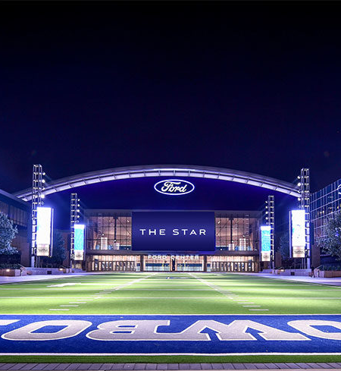
Key facts about Dallas Fort Worth
The Dallas–Fort Worth metroplex, officially designated the Dallas–Fort Worth–Arlington, TX Metropolitan Statistical Area by the U.S. Office of Management and Budget,[3] is a metropolitan area in the U.S. state of Texas encompassing 11 counties. It is the economic and cultural hub of North Texas. Residents of the area also refer to it as DFW, or the Metroplex.
The Dallas–Fort Worth metroplex's population is 7,539,711 according to the U.S. Census Bureau's 2018 population estimates,[4] making it the most populous metropolitan area in both Texas and the South, the fourth-largest in the U.S., and the tenth-largest in the Americas. In 2016, Dallas–Fort Worth ascended to the number one spot in the nation in year-over-year population growth.[

Slide 3
Where to open a mid-range Restaurant in the suburbs of North Dallas
Context
Criteria for ideal location
Location is important but distance is more important
Suburbs are car dependent
Restaurant and retail venues are clustered in commercial areas across the zone
Proximity to other successful midrange restaurants
Proximity to other businesses (groceries, shops, etc) or low range restaurants are regarded
Population density
Population affluency

Slide 4
Data sources : Demographics
Census.org
Zip-code.com bestplaces.net
Cities in scope are : Frisco, McKinney and Plano

Slide 5
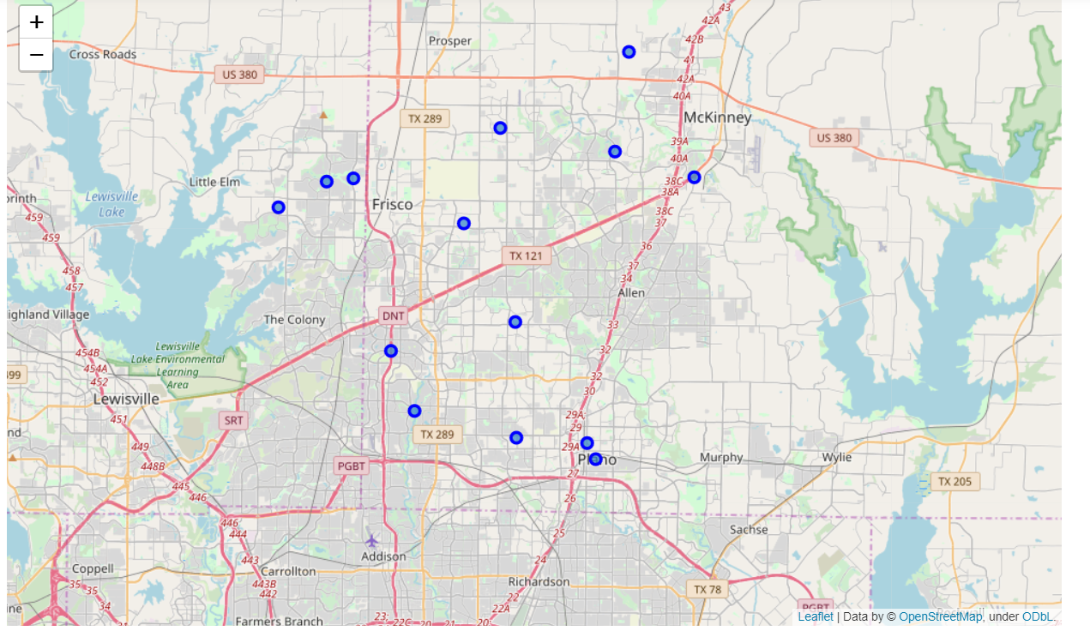
Data sources : geographical information
Representation of zip codes
Belonging to Frisco, McKinney &
Plano (Northern Dallas)
Source: Geopy (Google)

Slide 6
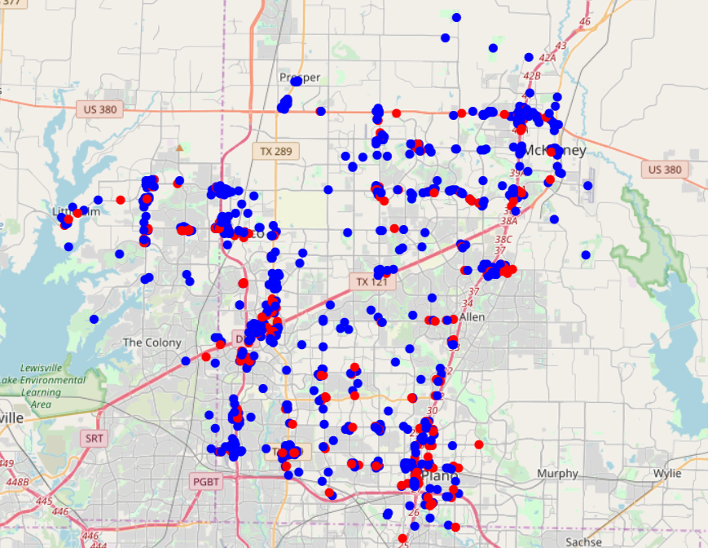
Data sources : Venue information
Representation of Venues (blue) &
Restaurants (red) within the zip codes
Source: Foursquare

Slide 7
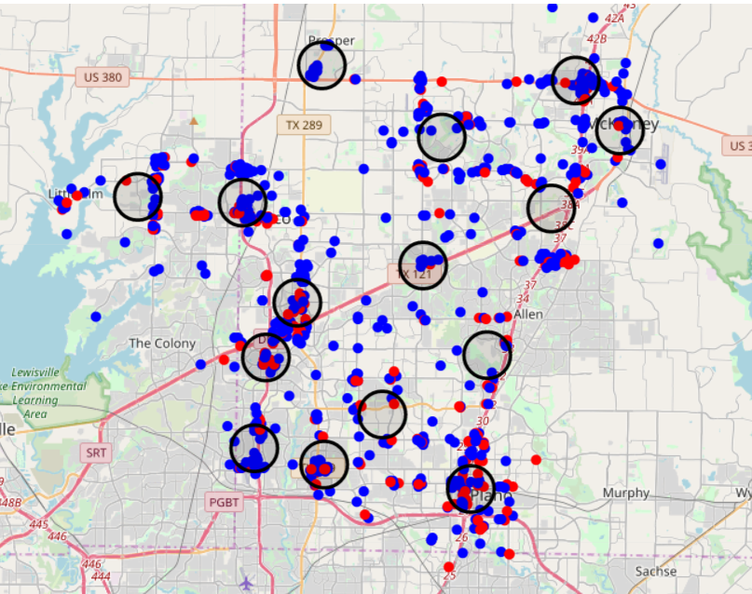
Methodology & analysis
Use of k-means to create venue clusters by geographical proximity

Slide 8
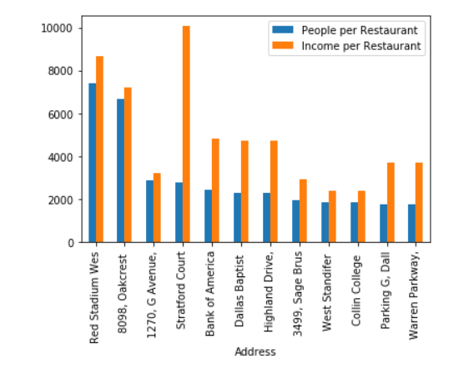
Methodology and analysis : pick the optimal locations
Top picks based on people per restaurant and income per restaurant data

Slide 9
Conclusion and future direction
Conclusions
Future Direction
Existing demographic data is only available at zip level.
Foursquare information combined with k-means analysis provided the necessary insights
Final decision accuracy limited to existing commercial information
Household level granular information will greatly improve accuracy
Availability of current and past company commercial data could be used to create a predictive model to forecast the success rate of a new restaurant

